Slide 1

File Systems and Disk Management
In computing, a file system or filesystem is used to control how data is stored and retrieved. There are many file systems known. Windows uses NTFS while Linux can choose from a great number of available file system types. To list kinds of fs the kernel supports we can type mksf. and use tab key. Ext fs is very common and below is a display of the evolution of this fs.
Ext - Solved 2 big problems that were found in the previous (Minix System): maximum partition size and filename length limitation to 14 characters
Ext2 - Added several things that lacked in Ext. Support for separate access, inode modification and data modification timestamps.
Ext3 - Added journaling to file system, online file system growth, tree indexing for larger directories missing from Ext3 and faster performance overall
Ext4 - is a large file system which supports volumes with sizes up to 1 exabyte and files with sizes up to 16 terabytes. It breaks 32,000 subdirectory limit found in ext3.It performs Faster file system checking and has multiblock allocator
Plan:
File System types
Disk Management Procedures and Commands
LVM
LVM Commands
MBR-based vs GPT Partition Table
Journaling
Permissions and unmask Command
Resources
by Iryna Diudiuk

Slide 2
File Systems and Disk Management
Useful commands:
mount –a to check whether after boot FS' would mount correctly on boot and/or to mount all filesystems mentioned in fstab without restart
lsblk - to view devices
lsblk –f (or blkid) for viewing graphically the first persistent schemes
sudo fdisk –l - to list devices
df –h – to list mounted devices and print sizes in powers of 1024
sudo vim /etc/fstab - edited to mount device on boot
sudo e2fsck -f /dev/sdd* - to check file system on errors
sudo mkfs* /dev/sdd* - to create and/or format file system on selected partition
cat /proc/filesystems - to see available filesystems supported by kernel associated with physical device
df -hT | awk '{print $1,$2,$NF}' | grep "^/dev" - to check partition type on the device
ls -l /dev/disk/by-uuid (or blkid )- to get UUID of the device
Points to remember:
In order to resize the storage space, we need to unmount the device, resize partition table first with e.g. fdisk command and then we need to resize the FS itself with resize2fs command which can be used on mounted partitions e.g. the root partition.
The exact sector position needs to be set via fdisk command in order not to lose any data during FS resize
There can only be one extended partition in MSDOS partition table (it can further be devided into logical parts)
Disk management procedures
When a new volume needs to be added the following steps are necessary:
physical storage added
its availability checked with lsblk command
partition table added and storage split into partitions depending on the type of partition table using parted, fdisk disk management tools. Otherwise, LVM device mapper choosen to work with logical volumes.
filesystem assigned via mkfs.* command
new mount point created at the appropriate location
new partition mounted with mount command into a new directory
new storage written into /etc/fstab file in order for the new space to be mounted on boot
by Iryna Diudiuk

Slide 3
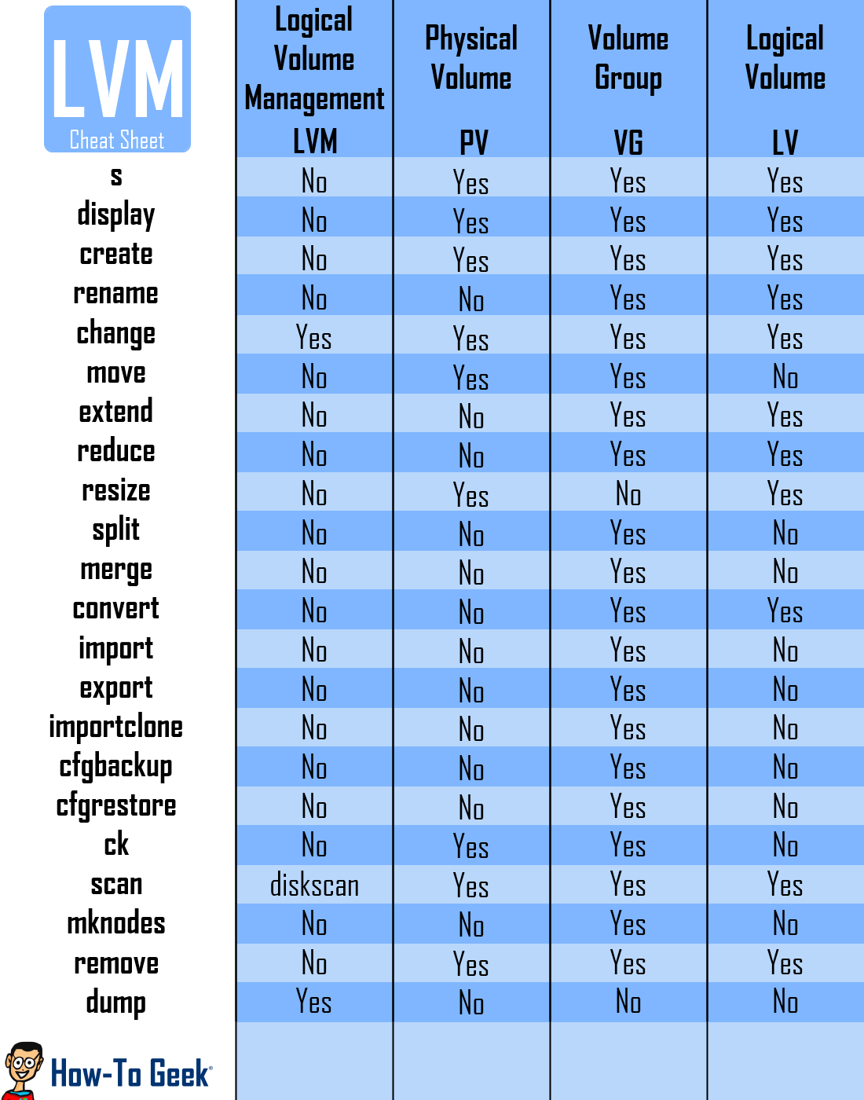
File Systems and Disk Management
Logical Volume Management (LVM)
is a disk management option.
logical Volume Manager allows for a layer of abstraction between your operating system and the disks/partitions it uses.
with LVM, disks and partitions can be abstracted to contain multiple disks and partitions into one device.
operating systems will never know the difference because LVM will only show the OS the volume groups (disks) and logical volumes (partitions).
it makes it easy to dynamically resize and create new disks and partitions. ﻿In addition, LVM can give you features that your file system is not capable of doing (Ext3 does not have support for live snapshots but LVM does)
you have the ability to take a snapshot of your logical volumes without unmounting the disk.
LVM helps to dynamically expand or combine multiple hard drives into a single pool of storage.
by Iryna Diudiuk

Slide 4
File Systems and Disk Management
Commands on Physical Volumes:
The following commands implement the core LVM functionality.
pvchange -- Change attributes of a physical volume.
pvck -- Check physical volume metadata.
pvcreate -- Initialize a disk or partition for use by LVM.
pvdisplay -- Display attributes of a physical volume.
pvmove -- Move physical extents.
pvremove -- Remove a physical volume.
pvresize -- Resize a disk or partition in use by LVM2.
pvs -- Report information about physical volumes.
pvscan -- Scan all disks for physical volumes.
Commands on Volume Groups:
vgcfgbackup -- Backup volume group descriptor area.
vgcfgrestore -- Restore volume group descriptor area.
vgchange -- Change attributes of a volume group.
vgck -- Check volume group metadata.
vgconvert -- Convert volume group metadata format.
vgcreate -- Create a volume group.
vgdisplay -- Display attributes of volume groups.
vgexport -- Make volume groups unknown to the system.
vgextend -- Add physical volumes to a volume group.
vgimport -- Make exported volume groups known to the system.
vgmerge -- Merge two volume groups.
vgmknodes -- Recreate volume group directory and logical volume special
files
vgreduce -- Reduce a volume group by removing one or more physical
volumes.
vgremove -- Remove a volume group.
vgrename -- Rename a volume group.
vgs -- Report information about volume groups.
vgscan -- Scan all disks for volume groups and rebuild caches.
vgsplit -- Split a volume group into two, moving any logical volumes
from one volume group to another by moving entire physical volumes.
Commands on Logical Volumes:
lvchange -- Change attributes of a logical volume.
lvconvert -- Convert a logical volume from linear to mirror or
snapshot.
lvcreate -- Create a logical volume in an existing volume group.
lvdisplay -- Display attributes of a logical volume.
lvextend -- Extend the size of a logical volume.
lvmchange -- Change attributes of the logical volume manager.
lvmdiskscan -- Scan for all devices visible to LVM2.
lvmdump -- Create lvm2 information dumps for diagnostic purposes.
lvreduce -- Reduce the size of a logical volume.
lvremove -- Remove a logical volume.
lvrename -- Rename a logical volume.
lvresize -- Resize a logical volume.
lvs -- Report information about logical volumes.
lvscan -- Scan (all disks) for logical volumes.
by Iryna Diudiuk

Slide 5
File Systems and Disk Management
GUID Partition Table
Supports disks larger than 2TiB.
Supports partitions larger than 2TiB.
Supports more than four partitions, with no distinction between primary, extended, and logical partitions.
Uses GUIDs as type codes, which means there's less risk of conflicting/duplicate codes.
Provides duplicate partition table structures at the start and end of the disk, which makes recovery from some types of user errors, bugs, and disk damage possible.
Provides checksums of important data structures, which enables detection of some types of partition table damage.
Provides a UTF partition description field, so you can give your partitions names. Note that this is independent of the name of the filesystem contained in the partition.
MBR-based partition table
MBR-based partition table schemes insert the partitioning information for (usually) four "primary" partitions in the MBR. One of these partitions can be extended further into logical partitions.
One of the main limitations is the usage of 32 bits for storing block addresses and quantity information. For hard disks with 512-byte sectors, the MBR partition table entries allow up to a maximum of 2 TiB (232 × 512 bytes).
by Iryna Diudiuk

Slide 6
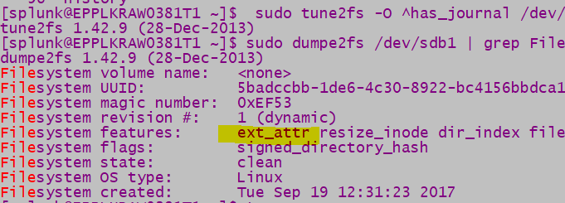
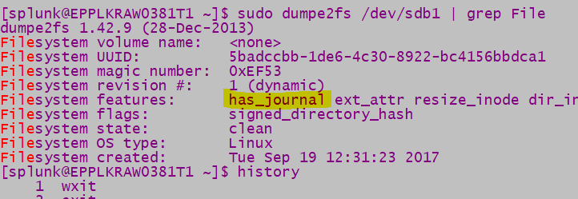
File Systems and Disk Management
Steps to disable and enable journaling
STEP 1: Unmount the file system partition whose journaling you wish to disable with umount command
STEP 2: Disable journaling for the file system using the following command (to disable journaling for an ext4 file system) sudo tune2fs -O ^has_journal /dev/sdb*
STEP 3: Perform a file system check using e2fsck –c /dev/sda*
STEP 4: Reboot
STEP 5: Verify that the file system has journaling disabled and the partition is mounted using sudo dumpe2fs /dev/sdb1 | grep Filesystem features
if has_journal is indicated it is enabled, if no, it is not mentioned at all
In order to re-enable journaling the steps above should be repeats all the STEPS above, but without the ‘^’ in STEP 2.
Below are the screenshots with enables and disables FS.
Journaling
ext3 and ext4 have the ability to write to a journal (Journaling file system), which logs intended changes to the filesystem so that when a system crash occurs in the middle of an operation, the OS can read the logs and complete it, ending up in a less corrupted state than without a journal.
by Iryna Diudiuk

Slide 7
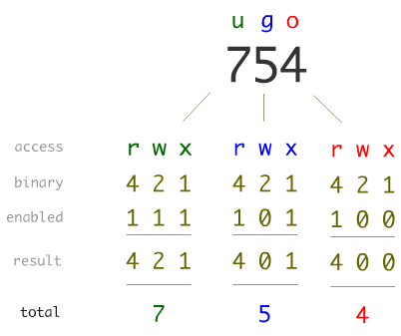

File Systems and Disk Management
UMASK
Generally, the mask only affects file permissions during the creation of new files and has no effect when file permissions are changed in existing files, however, the chmod command will check the mask when the chmod options are specified using symbolic mode and a user is not specified.
The mask is stored as a group of bits. It may be represented as binary, octal or symbolic notation. The umask command allows the mask to be set as octal (e.g. 0754) or symbolic (e.g. u=rwx,g=rx,o=r) notation.
The mask and the umask command were introduced around 1978 between the sixth edition and the eighth edition of the operating system, so it could allow sites, groups and individuals to choose their own defaults.
Defaults for Directories: rwx rwx rwx
Defualts for File: rw-rw-rw-
The picture below explains that first digit implies the rights that will be removed from owner (user), second – from group and third from other users). In this case the new file with have permission 774
Permissions in Linux
Permissions in Linux are changed with the help of command chmod. It changes the file mode bits of each given file according to mode, which can be either a symbolic representation of changes to make, or an octal number representing the bit pattern for the new mode bits. Example: “chmod 754 filename”. Below is a representation of rights in numeric way:
The chmod command lets add and subtract permissions from an existing set using + or - instead of = (e.g. to change a permission from r-- to rw-, you need to include r as well as w after the = in the chmod command invocation. If you missed out r, it would take away the r permission as they are being re-written with the =. Using + and - avoids this by adding or taking away from the current set of permissions). Example: “chmod g+w filename”
by Iryna Diudiuk

Slide 8
File Systems and Disk Management
Resources:
https://askubuntu.com/questions/19796/filesystem-types-for-partitions
http://cybergav.in/2011/11/15/how-to-disableenable-journaling-on-an-ext4-filesystem/
https://wiki.archlinux.org/index.php/Persistent_block_device_naming
https://www.howtogeek.com/howto/40702/how-to-manage-and-use-lvm-logical-volume-management-in-ubuntu/
https://askubuntu.com/questions/76913/how-can-i-check-if-a-particular-partition-ext4-is-journaled
http://www.tldp.org/HOWTO/LVM-HOWTO/upgraderoottolvm.html
https://askubuntu.com/questions/24027/how-can-i-resize-an-ext-root-partition-at-runtime
https://unix.stackexchange.com/questions/79395/how-does-the-sticky-bit-work
http://www.nix.ru/computer_hardware_news/hardware_news_viewer.html?id=187685
by Iryna Diudiuk

